Slide 1
Service Delivery Log Training
Notes:
Instructor Script:
Welcome to the ACT Service Delivery Log training. I am [trainer name] and I do [thing] at ACT.
Today we will learn how to fill out the Service Delivery Log (SDL) and its importance to ACT.

Slide 2
What is a Service Delivery Log (SDL)?
Records service hours with clients
Legal binding documentation of services
Collection of data for each session = Clinical requirement
It is just as important as the clinical piece!
Notes:
Instructor Script:
The Service Delivery Log is a record of logged in service hours provided by ACT therapists to their clients.
These notes are a legal document verifying services provided.
It reflects the time reporting, meeting information, observation information, and collection of signatures.
It is a clinical requirement for the therapist to collect data on their client and to document service data.

Slide 3
Example: Service Delivery Log
Notes:
This is an example of a Service Delivery Log also known as an SDL.
Instructor Action: Provide a copy of a blank SDL.
Instructor Script:
Each SDL Form has 4 session entries.
1 session entry is used per client. Do not use for more than 1 session.

Slide 4
Overview of the SDL
Why is it used?
Time sheet for Therapist to upload into Central Reach online
Tracks attendance information for each session
Proof services were provided by ACT
Notes:
Instructor Script:
The SDL is used to record the service time a therapist has with their clients, it is also the timesheet therapists use to upload into Central Reach.
The SDL tracks if a session occurred on time, was cancelled, or rescheduled by staff or the client.
The caregiver signature provides confirmation whether they did or did not participate in the session.
For auditing purposes, SDLs also provide proof of services provided by ACT to agencies such as Regional Center, DDS, etc.
They are stored/kept in client files.
Tracks attendance information for the session. ACT summarizes cancellations by ACT/therapists and late, cancelled, no shows by family to report back to funders and track compliance with attendance requirements; provides data to justify moving toward termination, etc.

Slide 5
When is the SDL used?
15 minutes before the end of each session
Use 1 session entry per client per session
When is it due?
By Monday before 9:00AM
SDL data recorded in Central Reach
Originals can be mailed or dropped off at the office
Delivering after office hours? Drop off at mail slot
Notes:
Instructor Script:
The best time to fill out this form is 15 minutes before the session ends.
This will give you time to catch details needed immediately for the SDL.
SDLs are cumulative across a month- can use last week’s SDL the following week if within the same month.
Remember the SDL is your timesheet and it will help you enter your hours into Central Reach for payroll purposes.

Slide 6
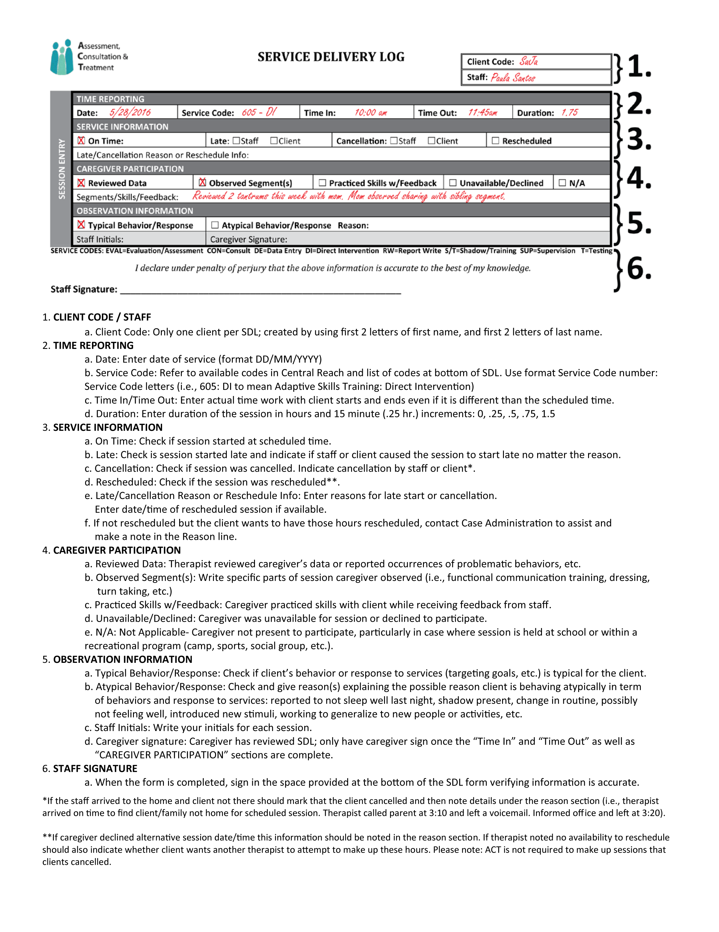
SDL Job Aid
Notes:
Instructor Action:
Hand out the PowerPoint activity sheet and the job aid.
Give the group a few minutes to look over the forms while speaking.
Instructor Script:
Today we will practice filling out an SDL form. We will use the activity sheet and job aid provided.
Using the PowerPoint activity sheet for practice, let’s review the purpose of each section and give you a scenario.
Use the scenarios to practice filling out the SDL form provided earlier
The job aid is your guide to help you fill out the SDL correctly.

Slide 7
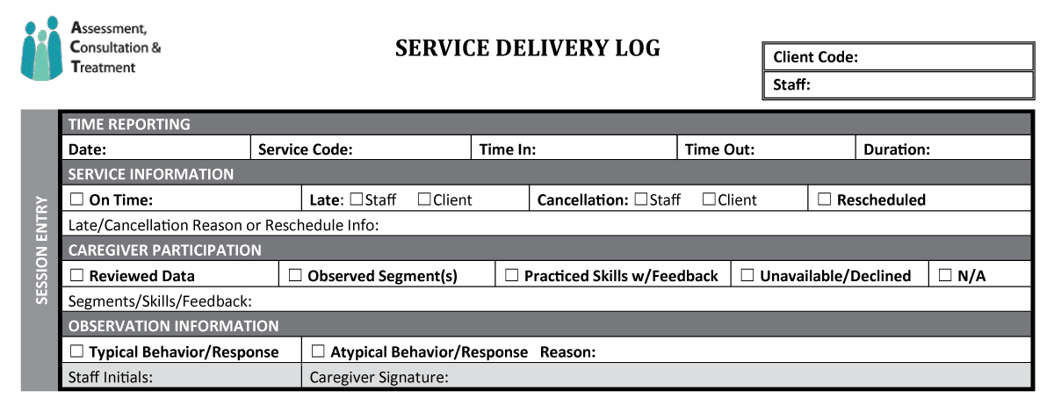
Client Code
Notes:
Instructor Script:
Let’s begin at the top of the page. For confidentiality purposes a client code is assigned to each client (this replaces their name).
Client codes are a combination of the first 2 letters of the clients first name, followed by the first 2 letters of the client’s last name.
In some cases there will be a number following these letters if there are multiple clients with the same initials; these client codes are also listed
with the client’s full name in Central Reach.
For example:
Client= Paula Santos Client Code= PaSa
Client= Pablo Sanchez Client Code= PaSa2
Under the client code, your name as the ACT staff is entered. Both items will be constant when working with the same client.

Slide 8
Client Code Activity
SaJa
Sondra Marin
Notes:
Instructor Script:
Scenario:
Sam Jackson is a new client and she needs a client code.
On your SDL practice sheet find the Client Code & Staff section, enter the client code should be and your name as the staff.
ANSWER: Client= Sam Jackson Client Code= SaJa
Instructor Action: Give everyone 30-60 seconds to do this practice. Then ask if they are done and move on.

Slide 9
Time Reporting
06/21/2016
EVAL
9:45am
11:45am
2.0 hr
Notes:
Instructor Script:
Next we will move on to the Time Reporting section.
This is where the date, time in, and time out are recorded for each session.
This data must be entered and match the time submitted in Central Reach.
The service code represents the medical services they receive.
If you are unsure of your clients service code(s), they can be found online on Central Reach.
On this example we have 06/21/2016 for the date, EVAL for the service code, Time in is 9:45am, Time out is 11:45am, and the duration is 2.0 hours.
Now let’s practice on the SDL form.
Using the PowerPoint Activity sheet:
Sondra is a new ACT therapist working with her client Sam. She began a two hour session with Sam at 10am. What time did Sondra end her session?
Choose the correct time and enter this along with the start time on the SDL.
Choices: a.) 12:00pm b.) 2/28/16 c.) 10:00am d.) EVAL

Slide 10
Service Information
06/21/2016
605 - DI
10:00am
12:00pm
2.0 hr
X
Notes:
Instructor Script:
The service information section is used to provide data on timeliness, cancellation, or rescheduling by staff or client.
If the sessions starts on time no other information is needed for this section.
If the session starts later or is cancelled, check if it was you or the client and write a brief explanation.
If the meeting was cancelled and/or rescheduled check the reschedule box and if a time was determined put it in the Late/Cancelled Reason or Rescheduled info box.
In this example, the session started on time.
Activity:
Use the SDL form and job aid if needed.
You were delayed by traffic to Sam’s last session. What box would you mark off on the Service Information section and where would you place the reason for being late?
Enter both in the SDL form.

Slide 11
Caregiver Participation
06/21/2016
605
10:00am
12:00pm
2.0 hr
X
X
Parent reviewed the behavior data for the session
Notes:
Instructor Script:
Caregivers are given the opportunity to participate in sessions. There can be more than one caregiver at a session.
If a caregiver is unavailable but a nanny, a grand parent or other legally responsible individual is available, they can participate.
Be sure to note their relation to the client in this section.
The caregiver participation section serves the purpose to share the feedback the therapist has given a caretaker.
This involves discussing problems with them during a session and/or providing recommendations of what to do, what not to do.
This participation is not limited to just one option.
You can check off more than one type of participation option, if more than 1 activity is completed with the caregiver(s).
The N/A Section is used only if caregiver training doesn’t apply to the setting (i.e., services provided at school without caregiver present).
Use the Activity Sheet :
Sam’s mother reviewed the behavior data and observed the therapist do language trials. She then attempted to do a few with Sam,
with the therapist providing guidance on what to do/and not to do.
For this session, which boxes would be appropriate for the therapist to mark off?

Slide 12
Observation Information
06/21/2016
605: DI
10:00am
12:00pm
2.0 hr
X
X
Parent reviewed the behavior data for the session
X
Notes:
Instructor Script:
The observation information section is where you provide brief feedback about a clients behavior during a session.
You will also put your initials and have the caregiver review and sign the session entry.
Typical Behavior is checked when there are no changes to the clients behavior in a session.
Atypical Behavior is checked when a client has unusually more or less behavior problems than usual,
reacted differently to interventions, or when goals were targeted.
Another way to gage this is to ask, “Did the client have a better than normal or worse than normal session?”
If the answer is yes, then the behavior is considered Atypical.
Atypical behavior can occur due to behavioral reasons or response to skills teaching.
If the behavior is Atypical please provide a reason.
Reasons can vary from being sick, hungry, new people observing, a different setting for the session, to being taught how to hold a pencil.
Be sure to provide the reason or reasons you attribute their behavior as Atypical.
Activity:
As Sam’s therapist you have noticed that her behavior was different today. Her dog was in a session with her for the first time.
Sam was much more calmer than normal. Usually she has a hard time sitting down for long periods of time. With her dog, Sam sat for most of the session,
which is unusual behavior in her sessions.
In the observation section would you consider this Typical or Atypical behavior and what could be the reason for the change in behavior?
Mark it off on the SDL form and provide a reason.

Slide 13
Staff Signature
Your signature is required on the SDL form
Notes:
Instructor Script:
The last section of the SDL is your signature declaring that all data collected on the form is correct.
Remember this is a legal document verifying services provided. It is fraudulent to misreport dates and times.
If you make a mistake on an SDL, do not white out or scratch out information.
Instead run a single line through the mistake and make an initial beside it.
Submission of the data on the SDL form is due before 9:00 AM every Monday on Central Reach.
Make sure the service times on your SDLs match your reported time in Central Reach.
Now share your practice SDL with another therapist to compare your responses.

Slide 14
F.A.Q.
If a parent is not around, can anyone else sign the SDL?
What if I submit my SDLs late?
I have uploaded my SDLs into Central Reach, what if I made an error or forgot to add complete information, should I revise in Central Reach?
Can there be more than 1 caregiver in a session?
I did not report the time we started and the time we ended the session, is it ok if I just have the Caregiver’s signature?
Notes:
Instructor Script:
Read the questions and give the answers.
Answer 1: If a legal responsible person for the child is present, they can sign it. These legal parties are nannies, teachers, relatives.
Answer 2: New hires will be given feedback by the office administrator. Repeated late submission may require non paid administrative time,
re-training how to fill out an SDL appropriately and how to upload in Central Reach.
Answer 3: Do not revise in Central Reach. Contact the office administrator. Manual adjustments will have to be made to entries.
Answer 4: Yes, be sure to offer both the opportunity to review and sign the SDL.
Answer 5: This is not acceptable and should be avoided! The SDL must be completed thoroughly and correctly for business practices and for auditing purposes.
The accuracy of the SDL is just as important as the clinical piece of the work we do.

Slide 15
Additional Questions
?
?
?
?
Notes:
Instructor Script:
Thank you for completing this training today.
Do you have any questions?

Slide 16
SDL QUIZ
Notes:
Instructor Script:
Provide the form SDL Quiz
Instructor:
Now a quiz will be given to test your knowledge without the use of a job aid.

